Slide 1

Shack Update: PC Amplified Speaker
Dave VE3OOI
December 2020

Slide 2

BACKGROUND
Prior Shack had old Amplified PC Speakers
Damaged and disposed of prior to move
Easier to buy PC speakers
Had LM386 Amplifier modules looking for a purpose

Slide 3
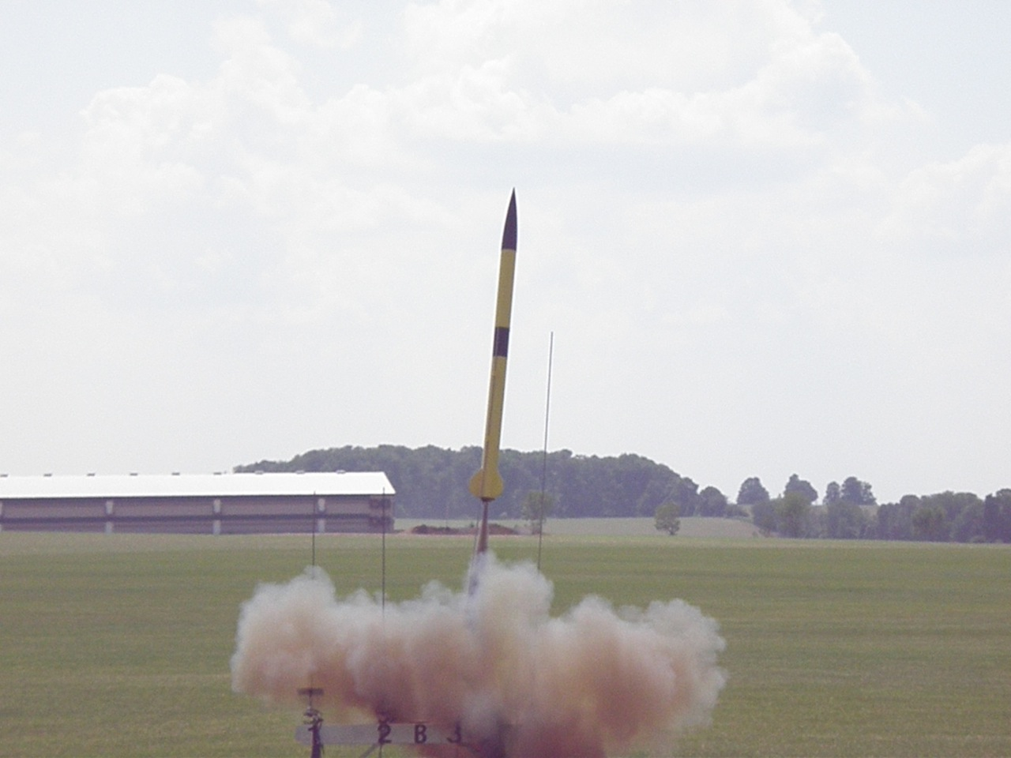
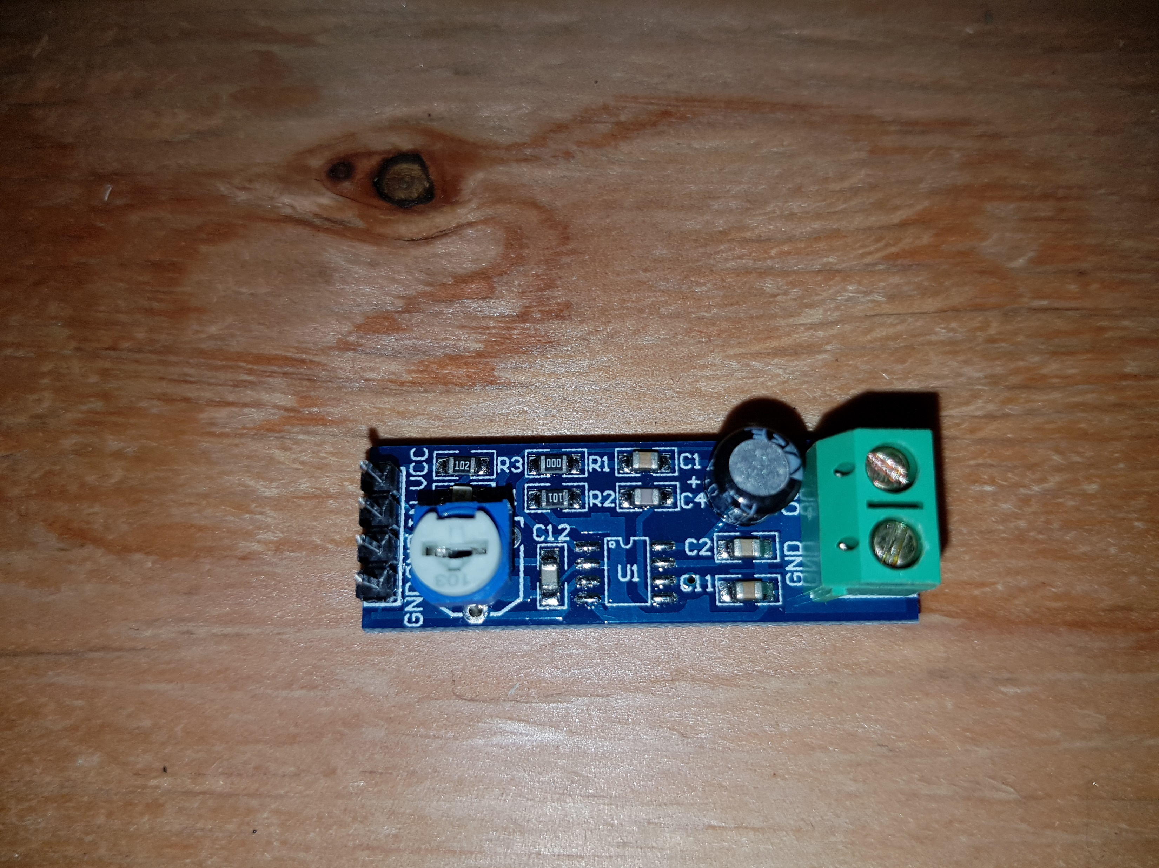
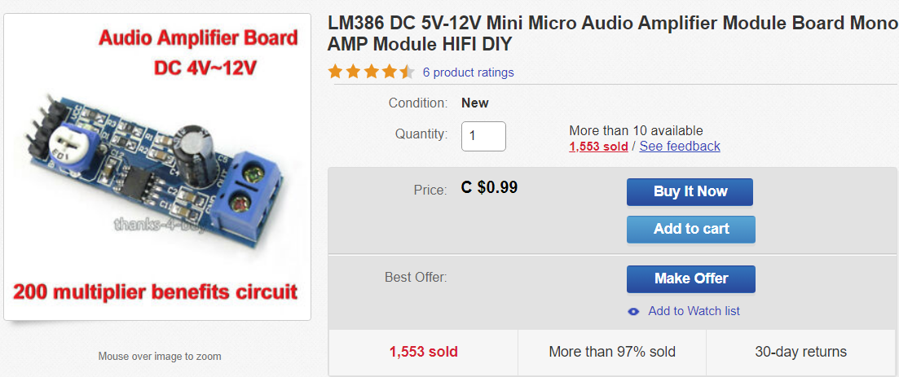
MODULE

Slide 4
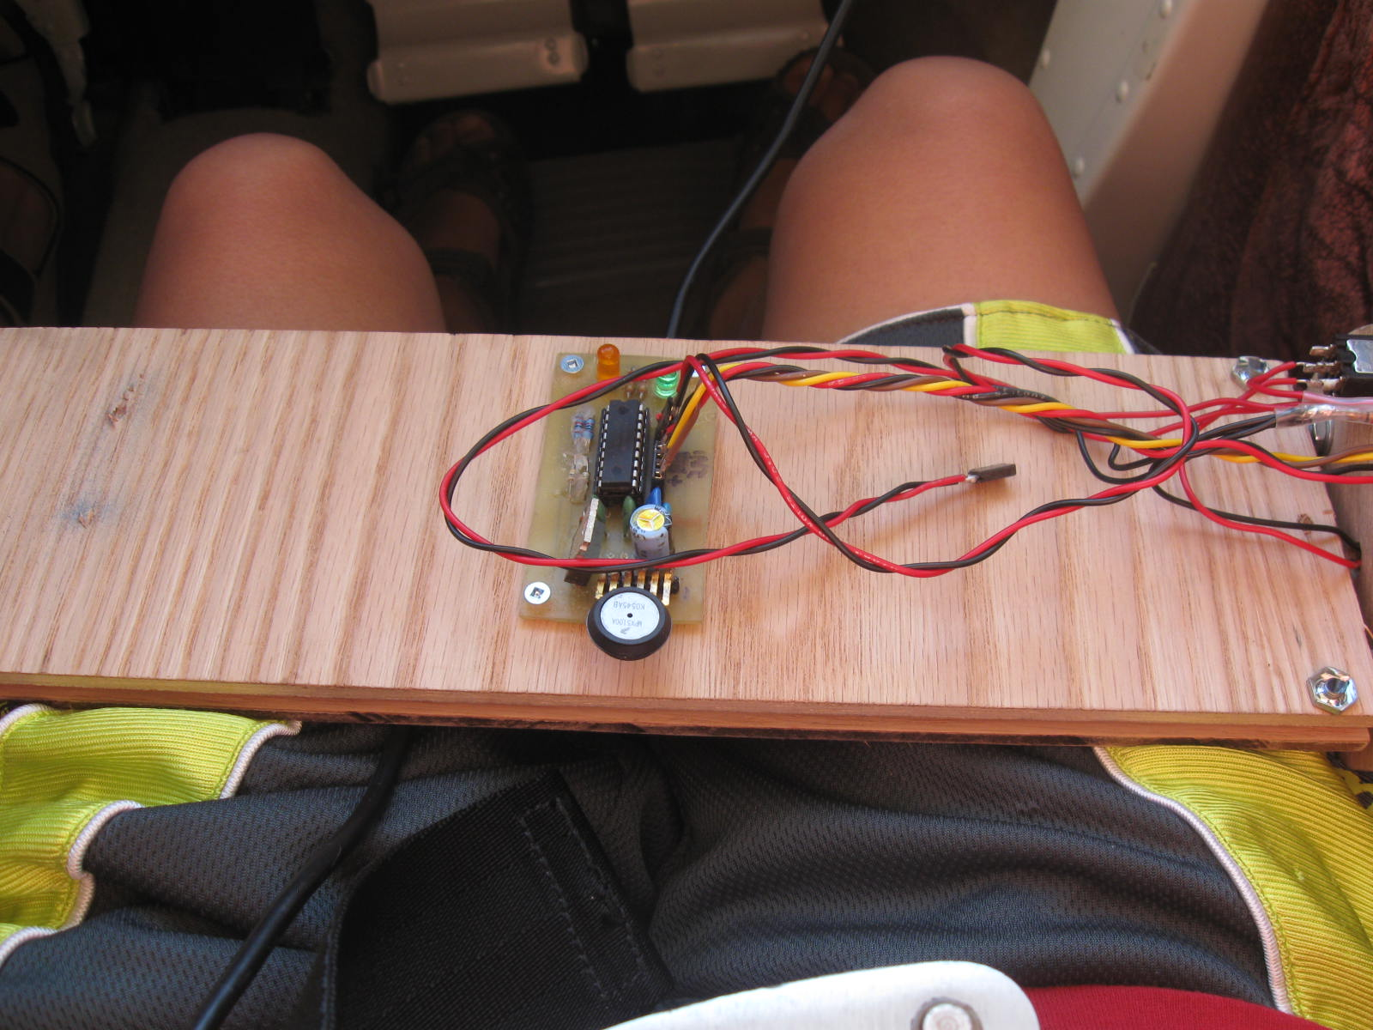
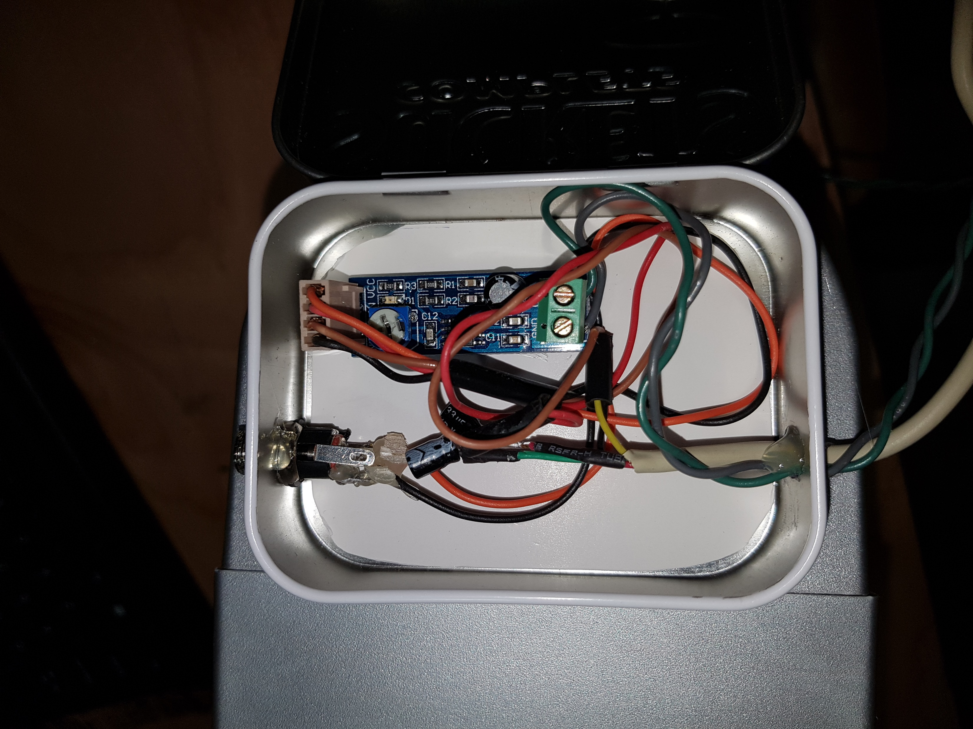
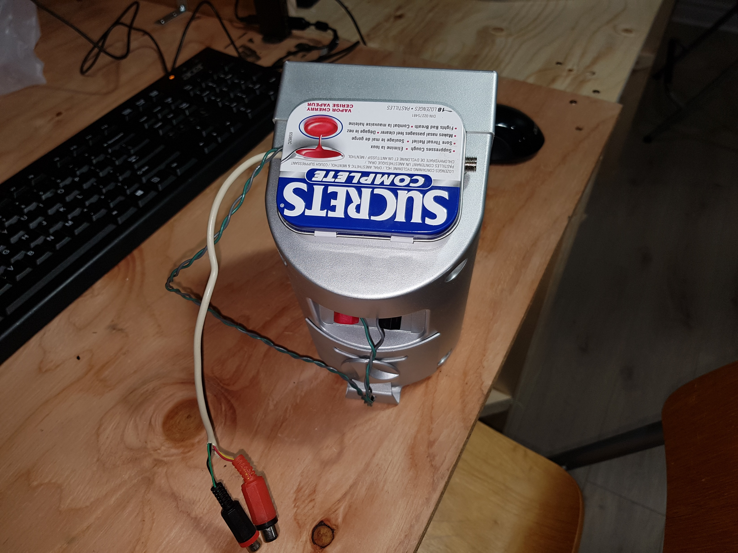
THE BUILD
Adjust volume for no distortion

Slide 5
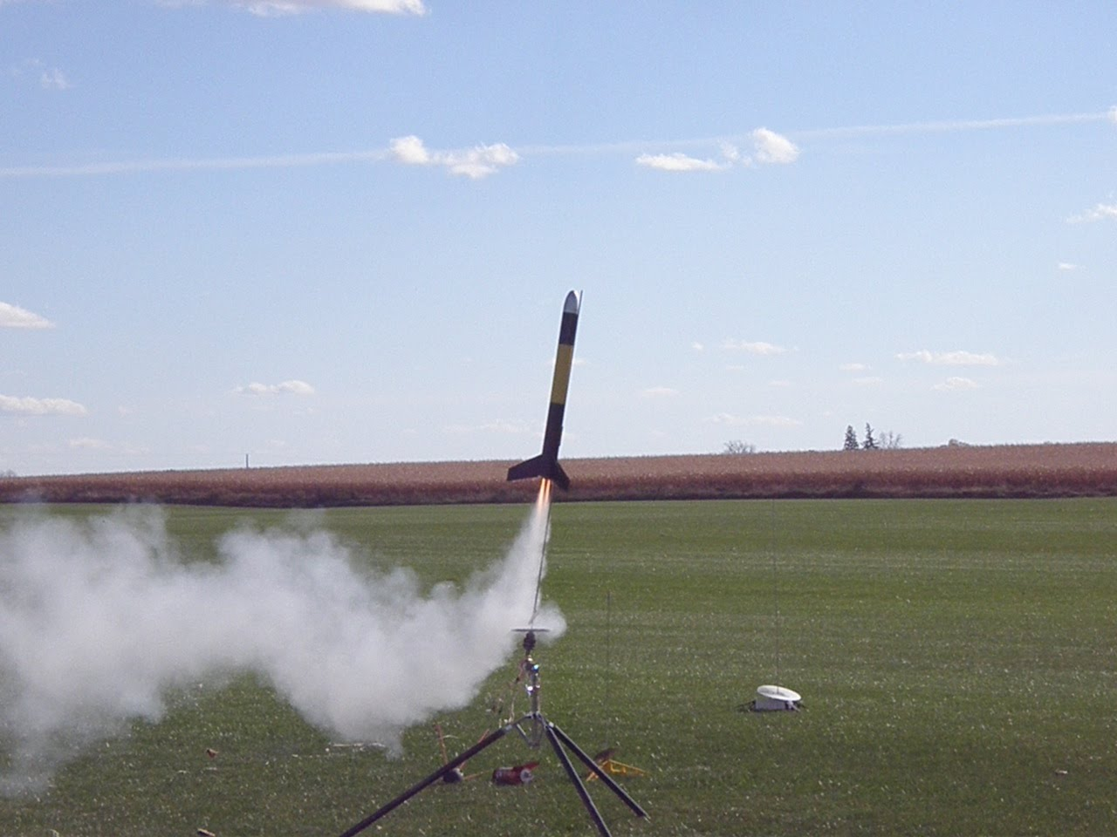
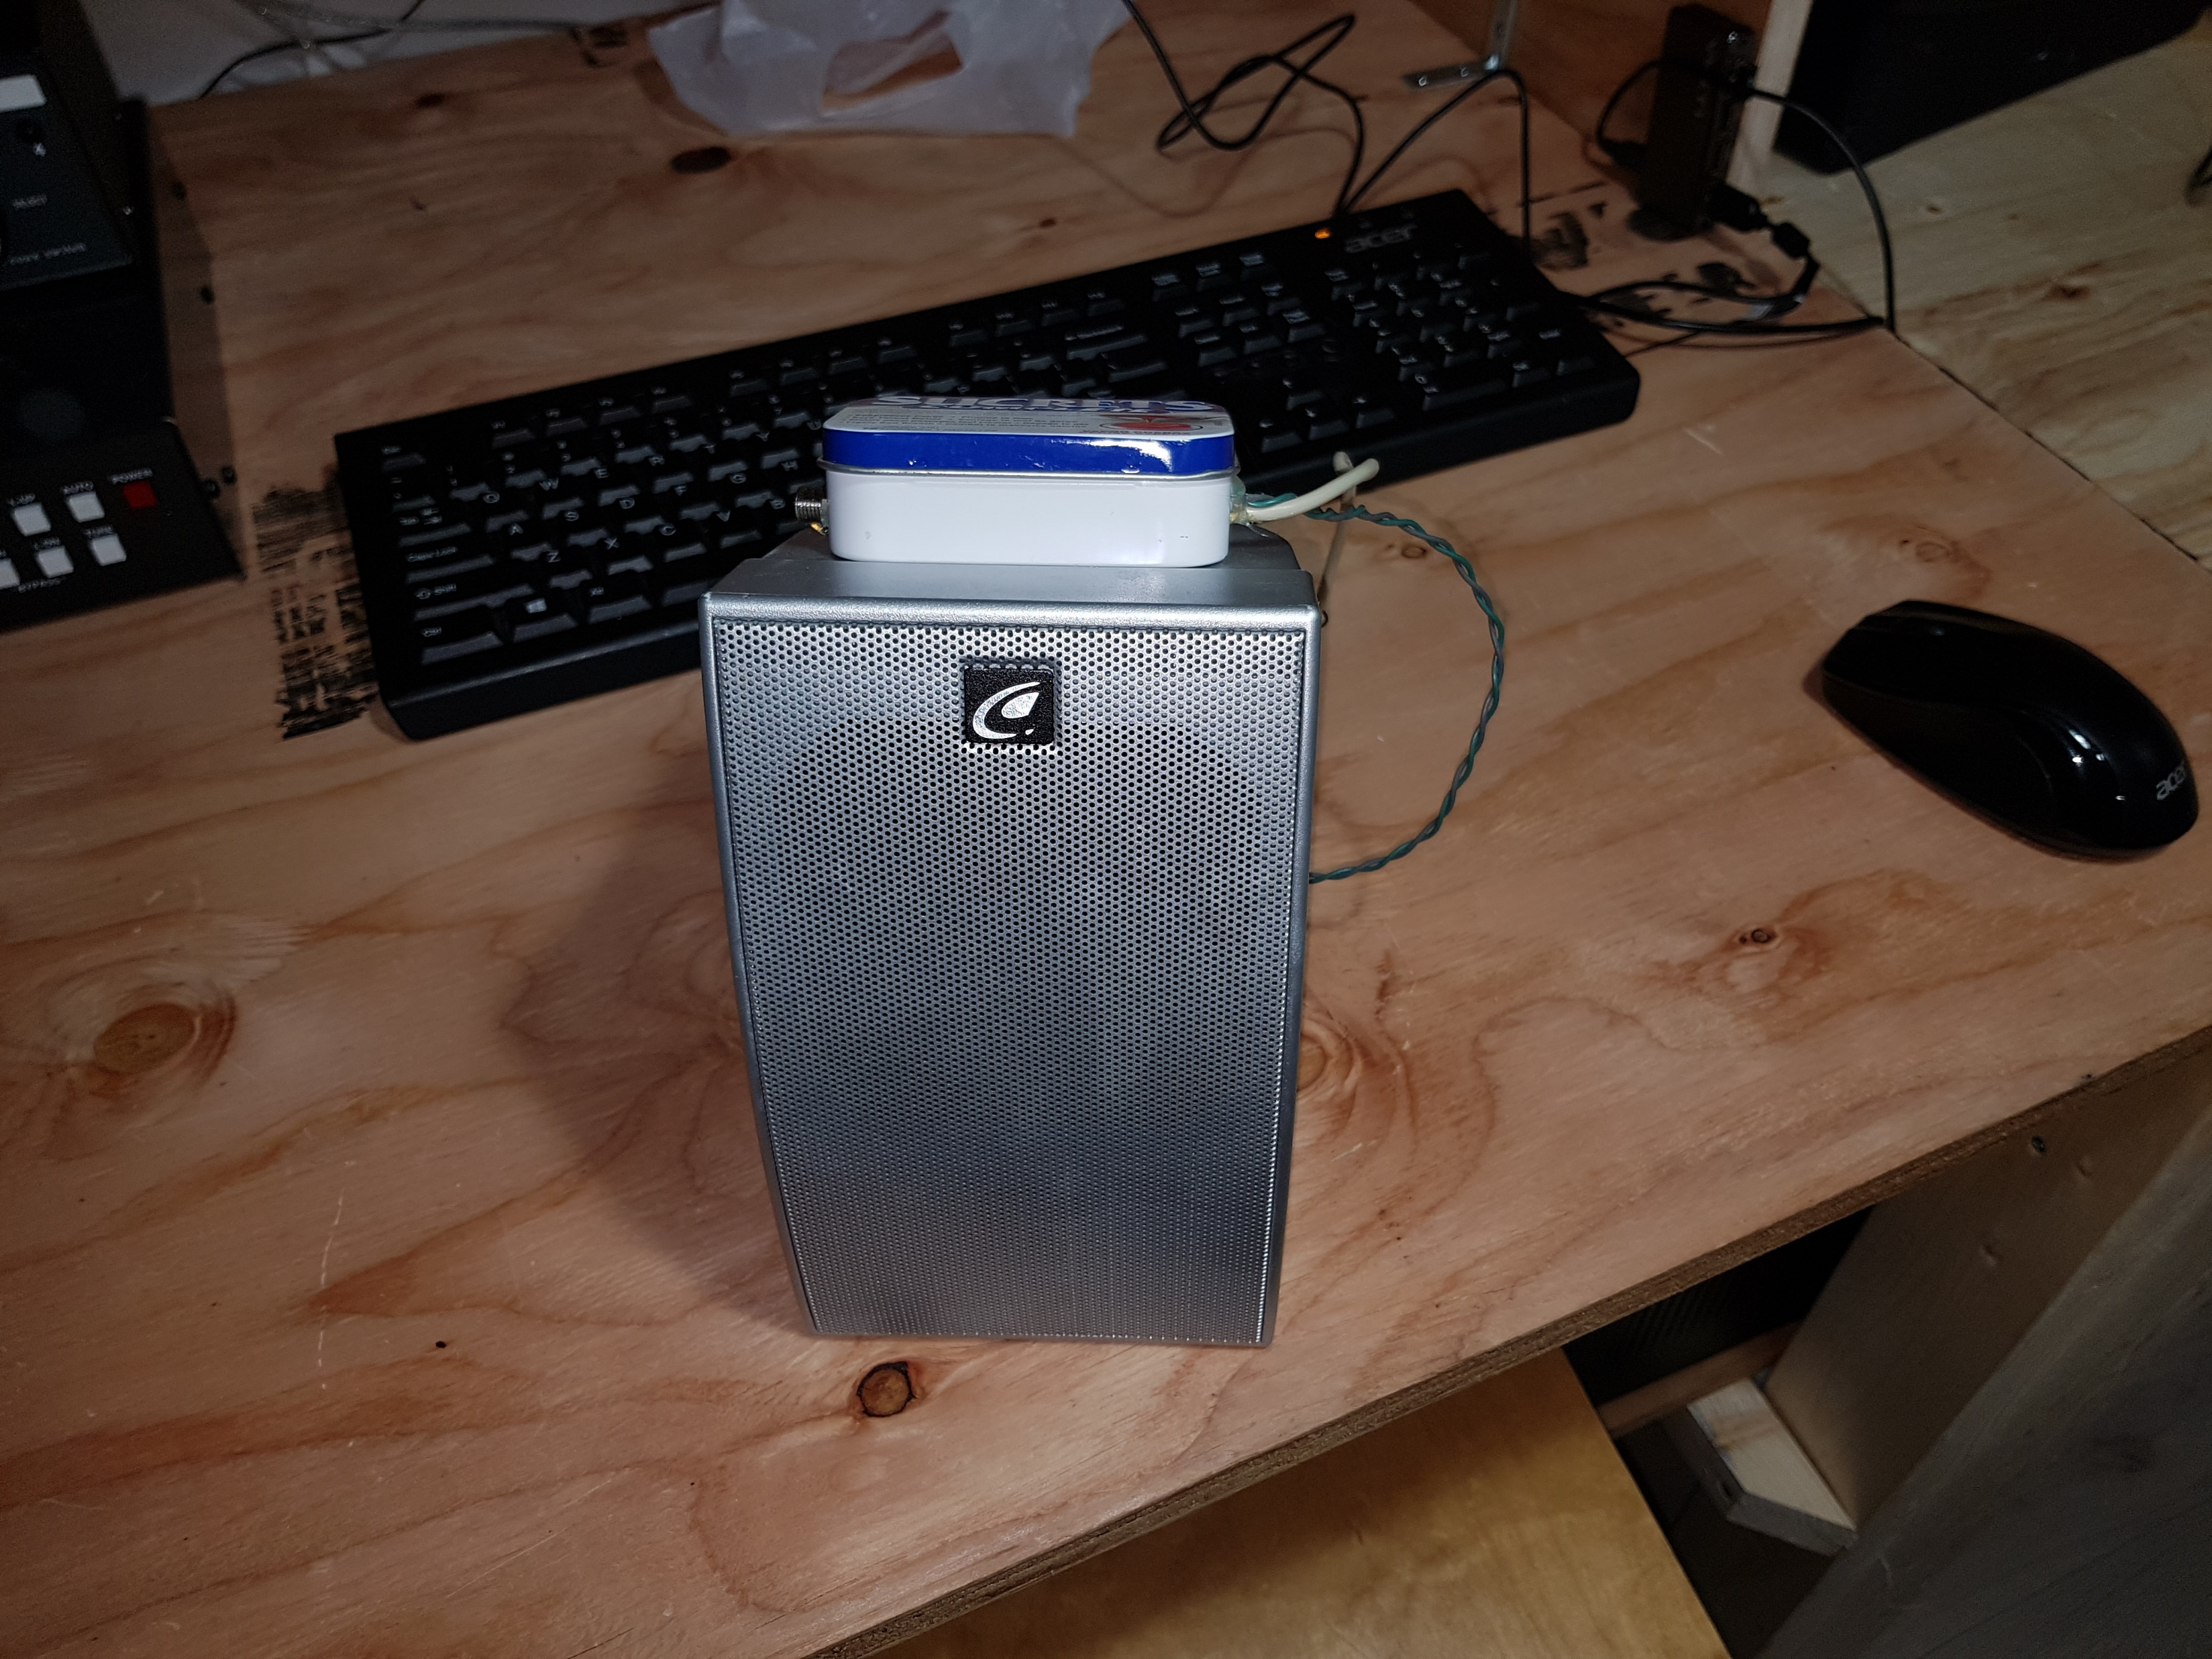

FINISHED PRODUCT

